Slide 1
Discrete Structures
Project Presentation
SKIP LIST
Group Member:- Muhammad Murtaza
Roll NO:- 19B-105-SE
Department:- Software Engineering

Slide 2
Skip List:-
A SKIPLIST is a probabilistic data structure. The SKIPLIST is used to store a sorted LIST of elements or data with a linked LIST. It allows the process of the elements or data to view efficiently. In one single step, it skips several elements of the entire LIST, which is why it is known as a SKIPLIST.

Slide 3
Why Skip List?
Linked list doesn’t support binary search.
Skip list allows fast search and insertion
Search: O(log n) time complexity on average
Insertion: O(log n) time complexity on average.

Slide 4
There are 3 parts in this presentation:-
Building a skiplist
Search
Insertion

Slide 5
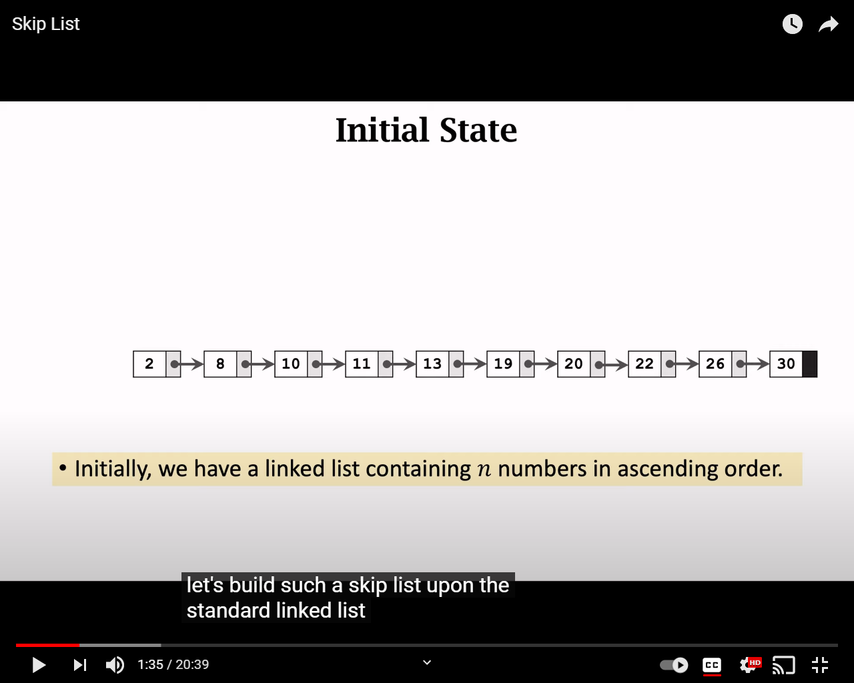
Building a Skiplist

Slide 6
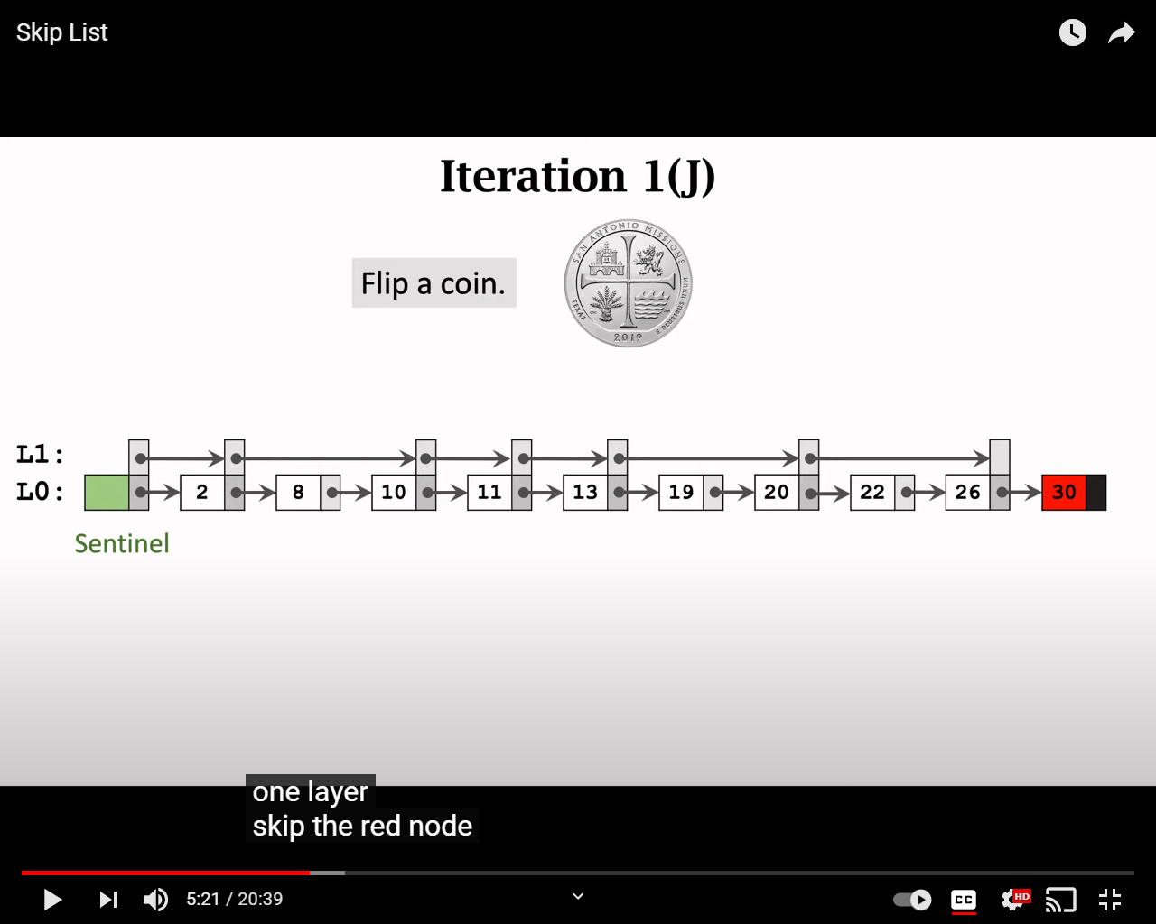

Slide 7
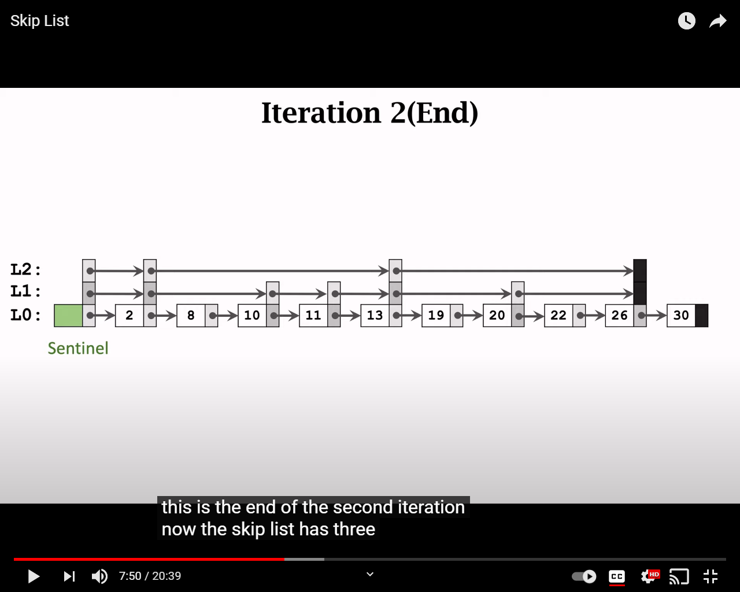

Slide 8
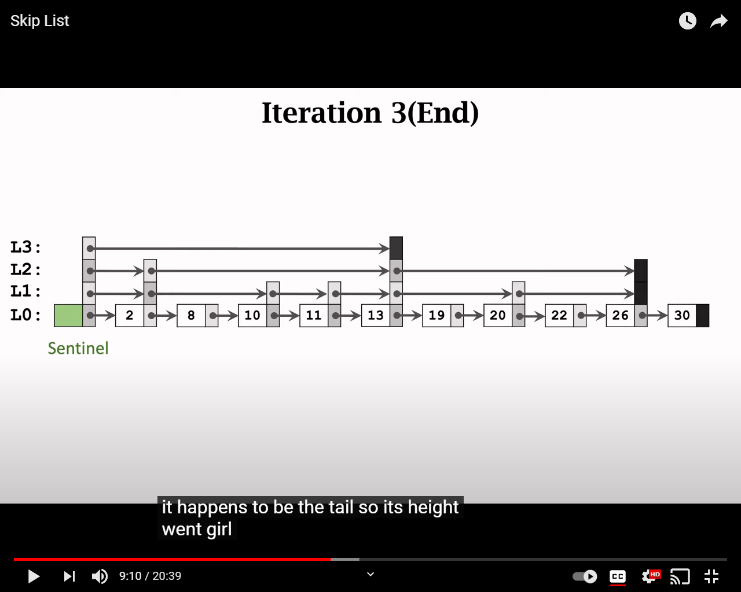

Slide 9
Search

Slide 10
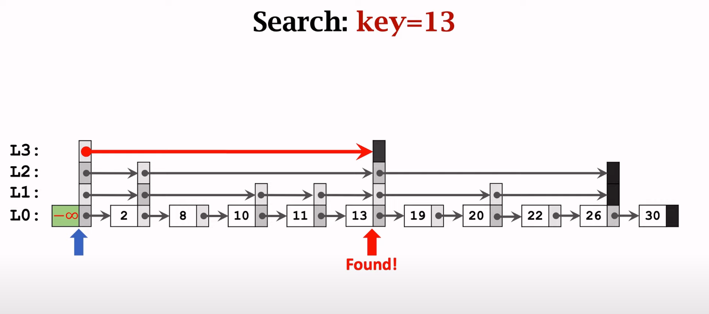

Slide 11
Insertion

Slide 12
